Slide 1
Hands on with FHIR
Baltimore, Sept. 2012 HL7 WGM
Grahame Grieve
Ewout Kramer
Lloyd McKenzie

Slide 2
Outline
Super-fast intro
FHIR Governance
Resource Development process
FHIR Tooling
Authoring considerations
Profile Development
Next Steps

Slide 3
Who are we?
Grahame Grieve
Australian, health interoperability – v2, v3, CDA, etc. tools, products, specifications, governance… http://www.healthintersections.com.au
Ewout Kramer
Chief architect & Manager R&D Furore
Dutch, architect in healthcare, messaging, data modeling, software development http://www.furore.com
Lloyd McKenzie
Canadian, data modeling, terminology, tooling, conformance
http://www.gordonpointinformatics.com

Slide 4
Caveats !
FHIR is a work in progress
Governance is just getting up and running
Processes will evolve (including based on feedback from this session)
FHIR itself continues to evolve

Slide 5
Presentation Style
For a good chunk of this tutorial, we’ll be hands-on
We may follow tangents based on questions asked
Slides will hopefully provide background when you’re working on your own
Our adherence to distributed slides is likely to be “limited”
However
We’ll update the presentation after-the-fact to cover anything we cover only verbally during the tutorial, so go download an updated copy after the WGM
http://gforge.hl7.org/svn/fhir/trunk/presentations

Slide 6
Quick Intro

Slide 7
30 second “Intro to FHIR”
As significant as leap from v2 to v3
Still leverage v3 infrastructure & knowledge
Pronounced “FIRE”
REST-enabled and based on resources but supports document, messaging & services paradigms too
All data is contained in a set of 100-150 resource definitions (for all of healthcare)
Resources contain the elements 80% of systems will actually use
Everything else is handled by extensions

Slide 8
More introduction to FHIR
If you want more, download the slides from the Q2 presentation:
http://gforge.hl7.org/svn/fhir/trunk/presentations

Slide 9
Governance

Slide 10
FHIR Governance
Trying to be “best practice” in terms of how FHIR is governed
Aligning with some of Thomas Earl’s ideas
Governance = FHIR Governance Board
Management = FHIR Management Group
Methodology = MnM
FGB and FMG both report to TSC

Slide 11
FHIR Governance Board
Responsible for establishing & maintaining “FHIR Principles”
Determine what resource names get allocated and who they get allocated to
Vet the processes used to manage FHIR
Appointed by TSC
Grahame Grieve – FHIR core
Ron Parker – Architecture rep
Woody Beeler – TSC rep
Ewout Kramer – Implementer rep
CTO – votes in event of tie

Slide 12
FHIR Management Group
Make day-to-day decisions about FHIR
Help committees with design
Mediate conflicts, ensure alignment & coherence across resources
Appointed by TSC
Reps recommended by FGB and by steering divisions and Affiliates Council
Membership to be finalized this month (look for discussions w/ TSC)

Slide 13
MnM
Responsible for documenting QA processes, best practices, etc.
Resolving “hot topics” around methodology
Open committee

Slide 14
Resource Development Process

Slide 15
Resource development process
Not a lot of resources have been developed yet
Therefore: This process is more theory than best practice
Feel free to alter the approach based on what makes sense for your committee
Provide feedback on lessons learned.

Slide 16
Steps to resource development
1. Create a PSS for FHIR development for your WG
Template on gForge
2. Figure out what resources you need
Look at RMIMs, CMETs, v2 segments, CDA sections as candidates
Review the criteria for what constitutes a resource on the FHIR wiki
Review the list of previously identified candidate resources (wiki)
Discuss with the FMG and other committees

Slide 17
Steps to resource development
3. Fill out a resource request and submit it
Template on the wiki
Request will be reviewed by FMG and decided by FGB.
Quite possible there will be some back and forth
4. Review source specifications
Before you get too far in designing a resource, take a look at all the various source specifications to get a sense of 80%

Slide 18
Steps to resource development
5. Use the tools to draft your resource
UML diagram to identify core constructs & elements
Excel spreadsheet to identify element properties & definitions
Spy or other editor for example instances (preferably more than one)

Slide 19
Steps to resource development
6. Iterate
Don’t do infinite detail on the first pass
Start with a sense of what the elements are and what works
Then build towards robust definitions, good RIM mappings and coherent constraints
If you can’t create good instance examples then not a lot of point worrying about tautological definitions or accurate RIM mappings

Slide 20
Steps to resource development
7. Ballot
The usual process – get feedback & respond
Pay particular attention to implementation-based feedback
Be wary of arguments over the 80%

Slide 21
Tools

Slide 22
FHIR tools
At present, there are 4 tool ‘types’ needed for FHIR development
Enterprise Architect for UML diagramming
Yes, you must use EA
Excel or OpenOffice for editing spreadsheet
XML Spy or “your favorite schema-validating XML instance editor” for examples & HTML editing
FHIR build process
List may evolve over time

Slide 23
FHIR Artifacts
4 artifact file types used to maintain a Resource definition
Excel XML file defining each element in the resource
[resourceName]-spreadsheet.xml
XHTML files defining guidance on use of resource (notes, search criteria, etc.)
[resourceName]-introduction.xml
[resourceName]-notes.xml
Instance example(s) of the resource
Name varies (should include ‘example’ and resource name
UML Diagram XMI package
[resourceName]-uml.xml

Slide 24
FHIR Artifacts
May also have example profiles (also defined using Excel spreadsheet XML)
All files in svn: http://gforge.hl7.org/svn/fhir/trunk/source/[resourceName]

Slide 25
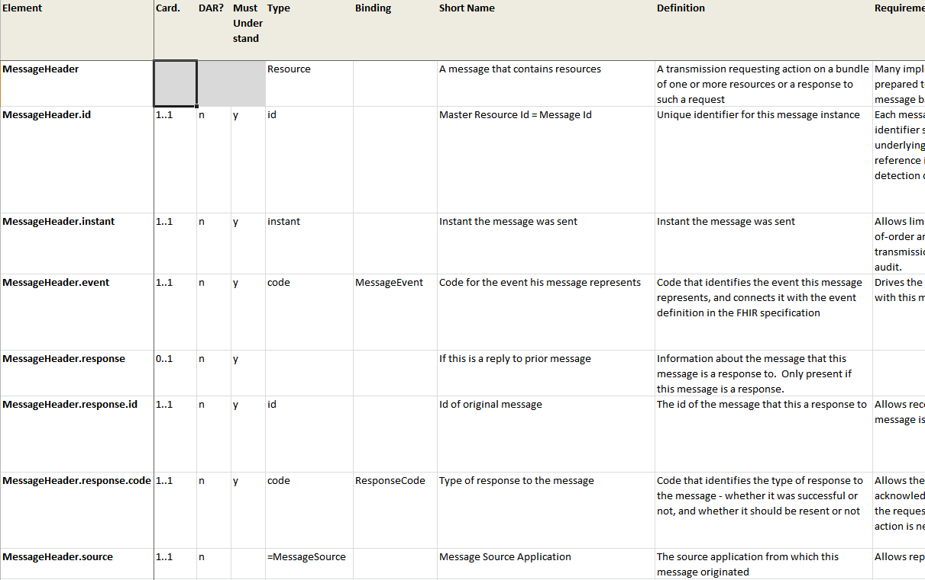
Master Definition: Spreadsheet
Stored as a Spreadsheet XML file (.xml)

Slide 26
Master Definition
Made of multiple tabs with specific names
Organization may change over time, but we’ll likely automate the transition
You may not use all the possible pieces

Slide 27
Data Elements tab
Defines all resource elements
Element name
Dot-separated full path
Determines schema element name
Cardinality: 0..1, 1..1, 0..* or 1..*
Inv: Reference to Invariant number(s) that governs appearance of this element
DAR: Data Absent Reason supported?
Must Understand: Systems must know what this element is, use caution before ignoring

Slide 28
Data Elements tab (cont’d)
Type: Datatype or blank. Special conventions for declaring type name for groups of elements, referencing previously declared elements
Binding: Reference to binding name from Bindings tab – what vocabulary goes here
Short Name: Name that appears in pseudo XML
Definition: What this element is
Requirements: Why we need it

Slide 29
Data Elements tab (cont’d)
Comments: Additional info that isn’t definition or requirements but relevant to implementer (e.g. usage notes)
RIM Mapping: Pseudo XML, format may change
For now, capture what makes sense to you
v2 Mapping: Segment, field, component, etc.
Todo: Not published
Committee Notes: Internal notes – not published

Slide 30
Invariants tab
Captures constraints
Id: Number referenced in Inv column of Data Elements tab
Name: Used in OCL
Context: Data element name that encompasses elements impacted by constraint
English: Constraint in human-readable form
OCL: Constraint in OCL form (optional)
XPath: Constraint in XPath 2.0 form

Slide 31
Search tab
Defines the search criteria for the resource
Name: Name of the criteria as used in HTTP call
Description: English language description
Type: FHIR datatype (must be primitive)

Slide 32
Bindings tab
Defines vocabulary bindings
Binding Name: Label used in Data Elements tab
Definition: Description of intended vocab content
Binding: How is this element bound
Code list – resource-specific set of codes
Value set – reference to codes from other code systems
Domain – Just the definition of a conceptual space
Strength: Must you use these codes?
Reference: tab where code list or value set defined or URL to reference
Description: Text to go with URL

Slide 33
[Code list] tab
Defines a set of codes used in a binding
Code: What appears on the wire
Display: What to show the user (defaults to Code)
Definition: What the concept means

Slide 34
[Value set] tab
Defines a set of codes used in a binding
Code: What appears on the wire
Code System: reference to system that defines the code
Display: What to show the user (defaults to Code)
Definition: What the concept means
More…

Slide 35
Examples tab
Defines the examples for the resource
Name: Descriptive label
Description: What does this example show/test/demonstrate?
Filename: What’s the XML file?
Type: Simple XML, or generated from data sheet
In Book: Is this example included in the FHIR book-form?

Slide 36
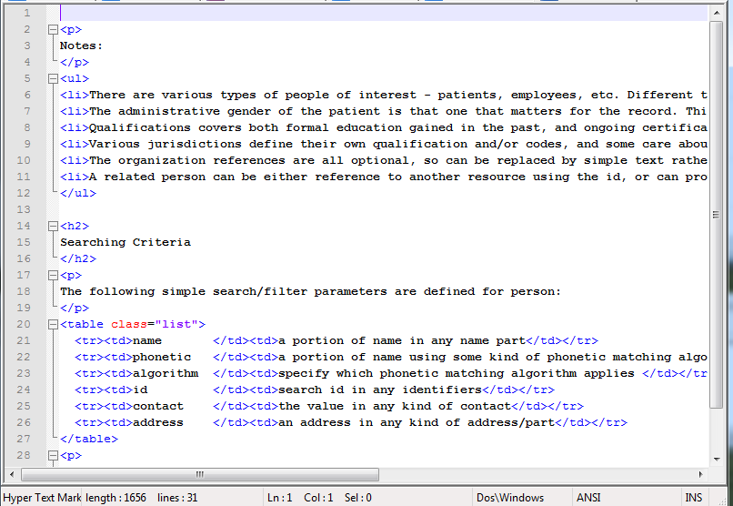
HTML (intro, notes)

Slide 37
HTML
Provides narrative about the resource
Introduction appears before data elements
Notes appears after
Focus should be “What does implementer need to know that isn’t covered elsewhere?”

Slide 38
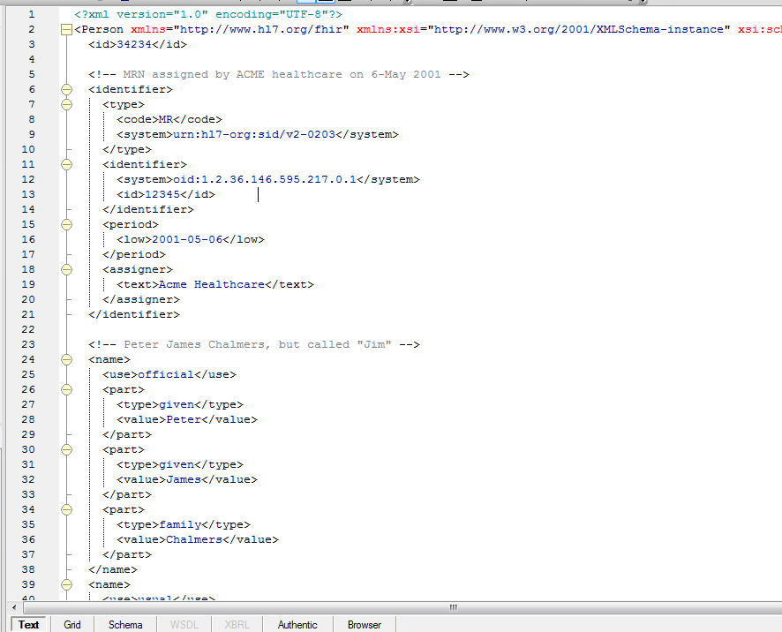
Example

Slide 39
Example
Can (and usually should) have more than one
Show how the elements are used
Show “common” usages/patterns
Don’t go crazy
Need to be able to maintain them
What (and how many) would be most useful for an implementer?

Slide 40
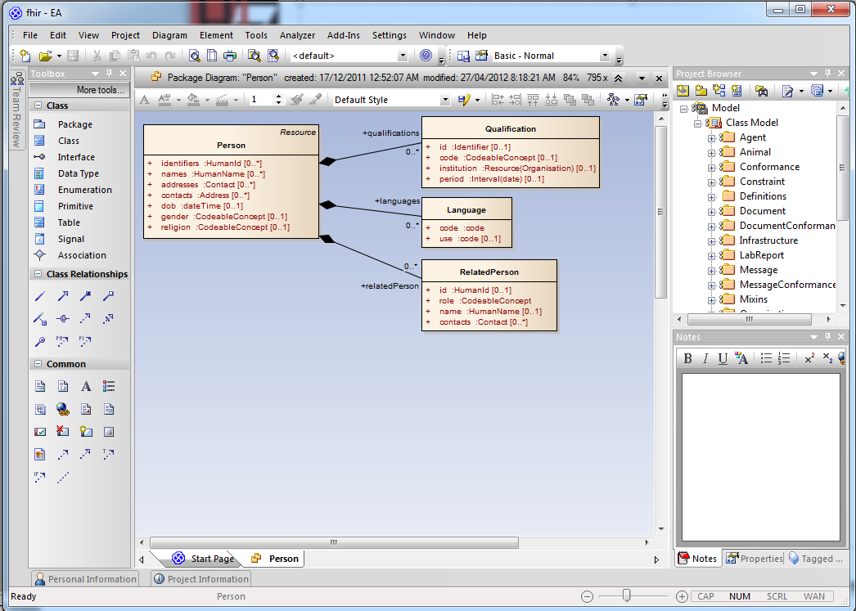
UML Diagram

Slide 41
UML Diagram
No new information beyond what’s in the Data Elements tab
Validated to be the same content
If we could do decent diagram auto-layout, we’d generate it
All associations shown as aggregations
Root “class” inherits from “Resource”
Use same convention as seen in existing resource diagrams

Slide 42
Build Process
Process:
Run publish.bat . (Needs Java runtime)
Checks & parses all source files
Runs internal validations to ensure coherence
Generates reference implementations
Generates schemas / JSON examples
Generates full specification
Validates examples against the schemas
Output:
Single directory, static htm/png/zip files
Host for web server (http://www.hl7.org/fhir)

Slide 43
Version Control
All FHIR definitions, source, etc. are subject to version control
Every committer can run the build process
Committers need to ensure the build process succeeds before committing
Much of the internal process enforcement for FHIR is delegated to social factors
i.e. a standard software development process

Slide 44
Resource Definitions
The Canonical definition is the object model created by parsing the artifacts
The artifacts are a convenient low-tooling svn-friendly way to maintain the definitions
Other formats could be introduced. Rules:
Low $$ tooling requirements
Subversion friendly
Easy-ish to parse content in java code

Slide 45
Authoring considerations

Slide 46
What are the rules?
The “rules” are still in flux and will evolve based on initial development experience
The base rules reflect the premises on which FHIR is based
see Introduction to FHIR presentation
There are however a few that have been developed so far

Slide 47
Resource Scope
Scope should ideally be broad enough to meet the potential needs of a wide spectrum of users
inpatient + community, individual & public health, human & veterinary, all countries & realms
If not possible, the space needs to be segregated such that multiple non-overlapping resources can cover the space
Name needs to be linked to scope, and part of scope definition
Must pass a “reasonable person” test

Slide 48
Resource Scope
Relationship between proposed resource and other resources needs to be well described
Direction of links needs to be understood
In both directions – what will reference this?
What is the life cycle?
Does it have a status?

Slide 49
Creating and editing content
Recommended inputs:
v3 Domain models
CDA, Consolidated CDA story and other implementation guides (and IHE specifications)
v2 segments & national implementations
openEHR Archetypes (http://www.openher.org/ckm)
National repository definitions (possible sources: S&I (including the CEDD), UK NHS, Canada Health Infoway, Singapore LIMs, NEHTA (Australia)) - beware of local variations
Demonstration…

Slide 50
How do we define scope?
Resources must not overlap
I.e. Given a clinical concept, there must be one (and only one) resource type that supports conveying that concept
Therefore, resource definitions must define clear boundaries between themselves and existing and expected resources
Should span all countries
Should span medical disciplines
Should usually even span human & veterinary

Slide 51
How do we decide 80-20?
First, look to your scope
Do 80% of all the existing systems covered by your scope use the element?
If your spec isn’t in use yet, would you expect 80% of all implementers within your scope to use the element?
Implementer = system responsible for maintaining that resource, not merely a system that references the resource
If unsure, err on the side of non-core rather than core (i.e. not in the 80%)
We can always move things based on DSTU

Slide 52
Element naming rules
Element names are lower camel case
U.S. English
Reflect domain-friendly terminology as internationally as possible
Are concise
Avoid abbreviations unless obvious to non-domain experts
Are consistent with other resources (where this doesn’t impact domain-friendliness)

Slide 53
Cardinality & optionality
Elements should only repeat if 80% of implementers will need repetitions
Elements should only be “mandatory” if the resource would be unusable without the data element present

Slide 54
Mappings
HL7 v3 mappings are mandatory
Syntax is still being finalized, but it will be x-path like
HL7 v2 mappings are mandatory if the resource has a corresponding construct in v2

Slide 55
Definitions
Definitions are mandatory
Must not be tautological
Should not be more than 1-2 sentences
Should describe what the element is, not what it is not
Should not include rationale or usage notes (other slots for these)
Should be accompanied by 3+ examples (Lloyd has a dream!)

Slide 56
More rules
Will be defined as we go along…

Slide 57
Profiles

Slide 58
Profiles
Edited in a spreadsheet, much like resource definitions
Metadata tab to define the profile
Extra column to allow “unpicking”
Can have multiple tabs to allow constraining multiple resources (or one resource multiple ways)
Can have tabs to define extensions

Slide 59
Next Steps

Slide 60
Individual “to do” list
Review the FHIR spec
http://www.hl7.org/fhir
Provide feedback
Contribute on wiki
http://wiki.hl7.org/index.php?title=FHIR

Slide 61
Work Group “to do” list
Draft a PSS for your committee to work on your resources
Submit resource requests for candidate resources
Start designing
Provide more feedback

Slide 62
Timeline
First DSTU ballot for Jan. cycle
“Locked” DSTU ballot for May cycle
no new resources for first release DSTU release of FHIR
First normative release of FHIR 2015 or 2016

Slide 63
FHIR this week
Full slate of sessions
Sun Q1 – Fri Q4
Refer to the on-site guide

Slide 64
Contacts
FHIR Mailing list: fhir@lists.hl7.org
Grahame: grahame@healthintersections.com.au
Ewout: e.kramer@furore.com
Lloyd: lloyd@lmckenzie.com

Slide 65
Licensing and Attribution
This presentation is copyright to HL7 International
It is licensed under the Creative Commons Attribution Non-commercial Share Alike 3.0 license
Details can be found here:
http://creativecommons.org/licenses/by-nc-sa/3.0/
The background image is sourced from quality3dmodels.net under the same license terms.

